Slide 1
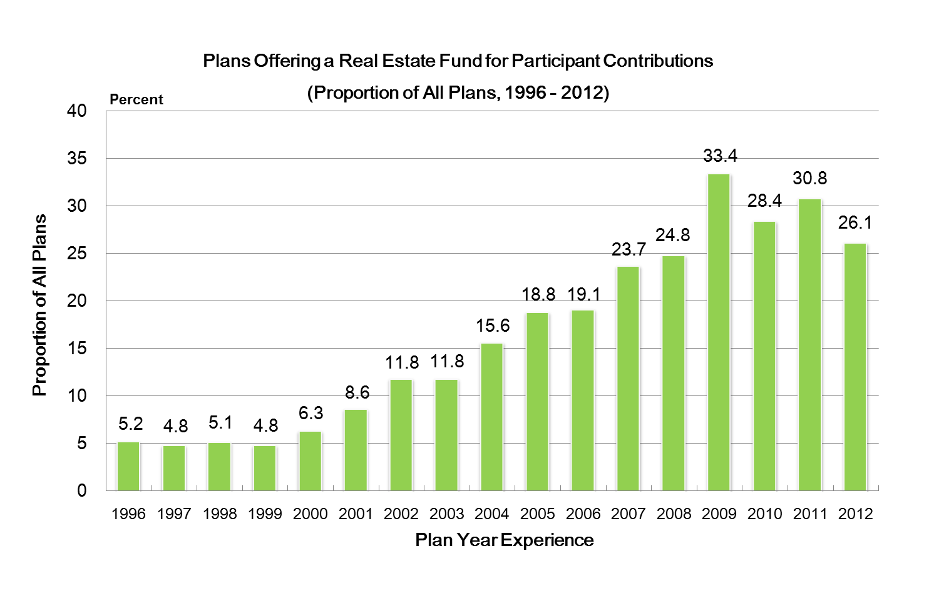
DC Plans: Trends in the Industry
401(k) Plans Offering a Real Estate Option
Source: Profit Sharing/401(k) Council of America

